Slide 1
Welcome!
Make yourself comfortable.
We will start soon.
Rick Cordray
Unit Commissioner
North Lakes District
rick@cordray.org
Notes:
Put this up as a lead-in slide until about 10 minutes before starting.
Put all the staff’s names on the title slide (#4)

Slide 2
Unit Service
The whole hope of the movement rests upon two assumptions:
That unit leaders can use the movement's program in a manner to make a difference in the lives of young people.
That district volunteers will do whatever is necessary to ensure every unit leader's success.

Slide 3
Finding Commissioners
They have to be people who can ‘jump the gap’

Slide 4
Jumping the Gap
The role of a district volunteer requires different kind of commitment and motivation than being a parent
The rewards of being a district volunteer are different than those of a parent

Slide 5
Commitment and Motivation
The Mission of the Boy Scouts of America is to prepare young people to make ethical and moral choices over their lifetimes by instilling in them the values of the Scout Oath and Law
Parents, to some degree or another, think this is worthwhile for their children
District volunteers must see it as worth their time and effort for the community

Slide 6
Rewards
The rewards of being a district volunteer are
Seeing progress toward achieving the mission of Scouting
Making and having fun with adult friends

Slide 7
Commissioners
What makes a commissioner successful?
(What makes a successful commissioner?)
Which points of the Scout Law are the most important?
What skills, experience, and/or talents are necessary?
Necessary!
Notes:
Knowledge
Relationships
Problem solving
Persistent
Trustworthy, Helpful, Friendly, Courteous, …. Brave?

Slide 8
New Commissioners
Are they going to have everything?
Knowledge
Experience
Manners
Contacts
Organization
???

Slide 9
Formula for Commissioners?
Very Effective!
Not Very Effective ☹
Good At Something
Great at Everything!

Slide 10
Commissioner Reality
Very Effective!
Not Very Effective ☹
Good At Something
Great at Everything!

Slide 11
Commissioners
The bad news is
Commissioners need oversight – the job is too important to leave to chance by just finding experienced people (if you can!) and trusting them
The good news is
Great experience is not a predictor of commissioner success – new Scouters can be successful as commissioners

Slide 12
Keys to Recruiting New Commissioners
Who’s a candidate – what do we look for?
Warm bodies?
Experience?
Existing relationship with units?
Looking for a place to show off their knots?

Slide 13
My Thoughts
Recruit for retention
What makes people accept?
What makes people continue?
What makes people stay?

Slide 14
Why Accept?
Challenge
But not too scary
Responsibility
But a safety net
Reasonable time demands
Support – not going at it alone
Asked by a friend

Slide 15
Why Continue?
Not oversold
Job is as advertised
Progress
Training happens, helps
Units improve
Find more friends

Slide 16
Why Stay At It?
Rewarding
Unit service works
Expanding horizons
Can see the bigger picture
More efficient with more experience
District and unit friends

Slide 17
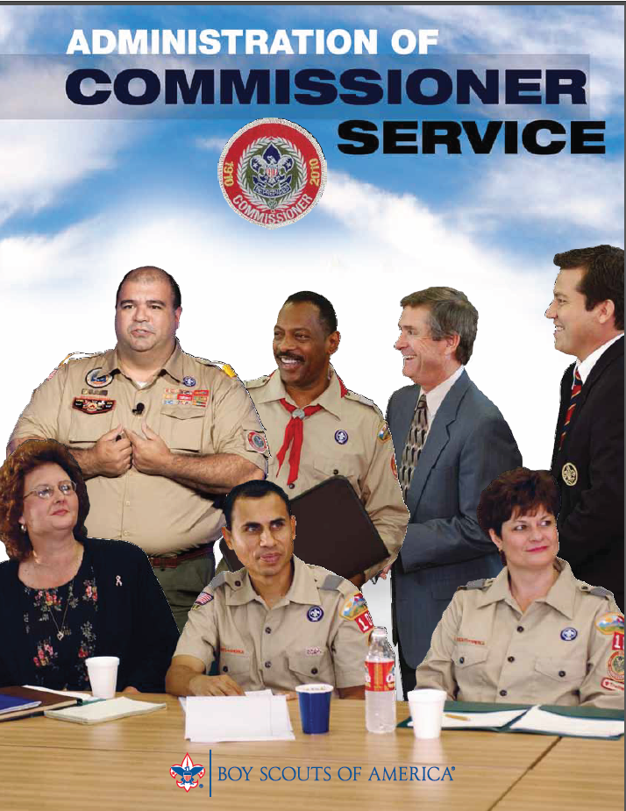
How to Recruit - Our Textbook

Slide 18
Methods for Recruiting – Textbook Approach
Determine what commissioner positions are needed.
Determine the best prospects for the position.
Research the prospects at the top of your list.
Make an appointment.
Make the sale.
Ask for a commitment.
Have a fall-back position in mind.
Follow up.

Slide 19
Designing for Exceptions
Easy
Not so easy (a.k.a. real world)
A
B
C
D
E
A
B
C
D
E

Slide 20
What’s The Big Picture?
Target council goals are
Every unit has a unit commissioner
No more than 3 units served by a commissioner
Full commissioner staff – roundtable, ADCs
District committee has 20+ members in each district

Slide 21
Do The Math
1050 units = 350 unit commissioners, maybe 70 ADCs
12 districts = 90+ roundtable commissioners and staff
12 districts = 240 district committee members
= 700 district level volunteers?

Slide 22
Compounding the Problem
Many dedicated Scouting volunteers cheerfully tackle many jobs and do their best.
Too many jobs are given only partial attention.
How many volunteers wear too many hats?

Slide 23
How Do We Get There?
“If every unit in the country would just recruit 2 new Scouts, membership would grow by….”
Remember ‘designing for exceptions’

Slide 24
What’s Hardest?
What’s the hardest part of recruiting for you?
How urgent is the need?
How important is the need?

Slide 25
Friendstorming (and Friendstorming on Tour)
Grew out of need at the council level
Hardest problem, in my opinion, was identifying enough potential candidates to get beyond everyone’s 2-3 acquaintances
Friendstorming was intended to get past this roadblock
Developed in Chief Seattle Council in 2004-2005

Slide 26
Friendstorming
Promoted regionally in 2007-2009
Rolled out nationally in 2010
Now part of professional development training
It works

Slide 27
How Does It Fit In?
Determine what commissioner positions are needed.
Friendstorming to develop prospect list
Determine the best prospects for the position.
Research the prospects at the top of your list.
Make an appointment.
Make the sale.
Ask for a commitment.
Have a fall-back position in mind.
Follow up.

Slide 28
My district and council volunteer philosophy:
We are here because
We believe in the promise of Scouting
We are having fun with friends

Slide 29
Friendstorming
Friendstorming – a tool to identify prospects
The purpose of Friendstorming is to expand the pool of prospects beyond our personal list

Slide 30
The Potential
Friendstorming can
Kick off an effort to double or triple the number of people involved…
As commissioners, committee members, trainers, roundtable staff, and other district positions.
Be part of a continuing recruiting program

Slide 31
Friend-storming
Friendstorming on Tour is the result of brainstorming about ways to find new friends.
Especially people who would fulfill the commissioner role.
Being a “friend to the unit”.
A typical Friendstorming on Tour meeting (at a district) turns up as many as 100 names.
These are potential new district volunteers.

Slide 32
Nuts and Bolts
Friendstorming On Tour is a series of meetings conducted at every district in the council.
But you can do just one locally.
Those attending are asked to bring names to think about.
As many as possible.
It’s possible to produce a list of 100+ names in one hour.

Slide 33
The Tour
Select two “tour guides” for each meeting.
A senior council volunteer and one executive.
Train & rehearse as necessary.
Promote the meeting to the district committee and commissioners.
Have the district leaders gather lists to help people remember names.

Slide 34
The Meeting Agenda
Introduce the people leading the session.
Explain the purpose.
Tell a story…
Review the Rules
We only want names.
Please avoid saying no for a prospect.
Please don’t worry about which position might be filled by the names you offer

Slide 35
Agenda continued….
Begin the “Friendstorming”
Stick to the schedule
Close with “The Pledge”

Slide 36
Next Steps
Get the list typed up.
The “tour guides” send out a thank you letter to the district Key 3.
The district Key 3 proceeds with recruiting.

Slide 37
Making It Work
The district Key 3 are tasked with follow up and recruiting some of the prospects.
Other district volunteers may participate, but the Key 3 are primarily responsible.
Nominating committee?

Slide 38
Completing the Task
Determine what commissioner positions are needed.
Friendstorming to develop prospect list
Determine the best prospects for the position.
Research the prospects at the top of your list.
Make an appointment.
Make the sale.
Ask for a commitment.
Have a fall-back position in mind.
Follow up.

Slide 39
Making the New Commissioner Successful
Get them some training
Get them some resources
Set reasonable expectations
Respect their experience (close to zero?)
Encourage

Slide 40
Making It Really Work
Make recruiting a priority.
It takes a lot of people with hands-on support to make unit service work
Friendstorming is an ongoing process.
Train everyone to keep their eyes open
Think ahead

